Slide 1

Towards Better Generalization of Adaptive Gradient Methods
Yingxue Zhou, Belhal Karimi, Jinxing Yu, Zhiqiang Xu and Ping Li
Baidu Research
NeurIPS 2020

Slide 2
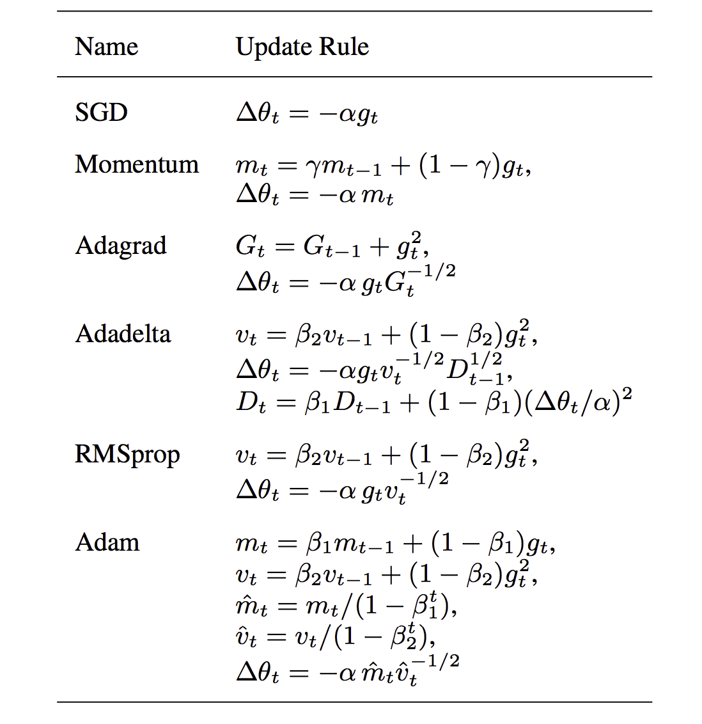
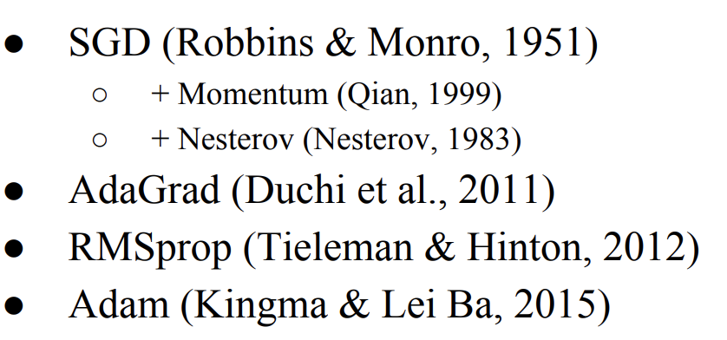
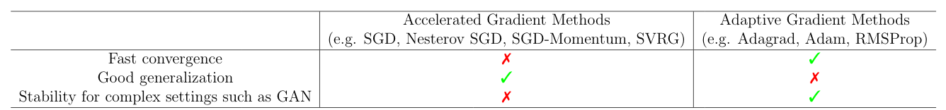
First-order gradient optimizers for deep learning

Slide 3
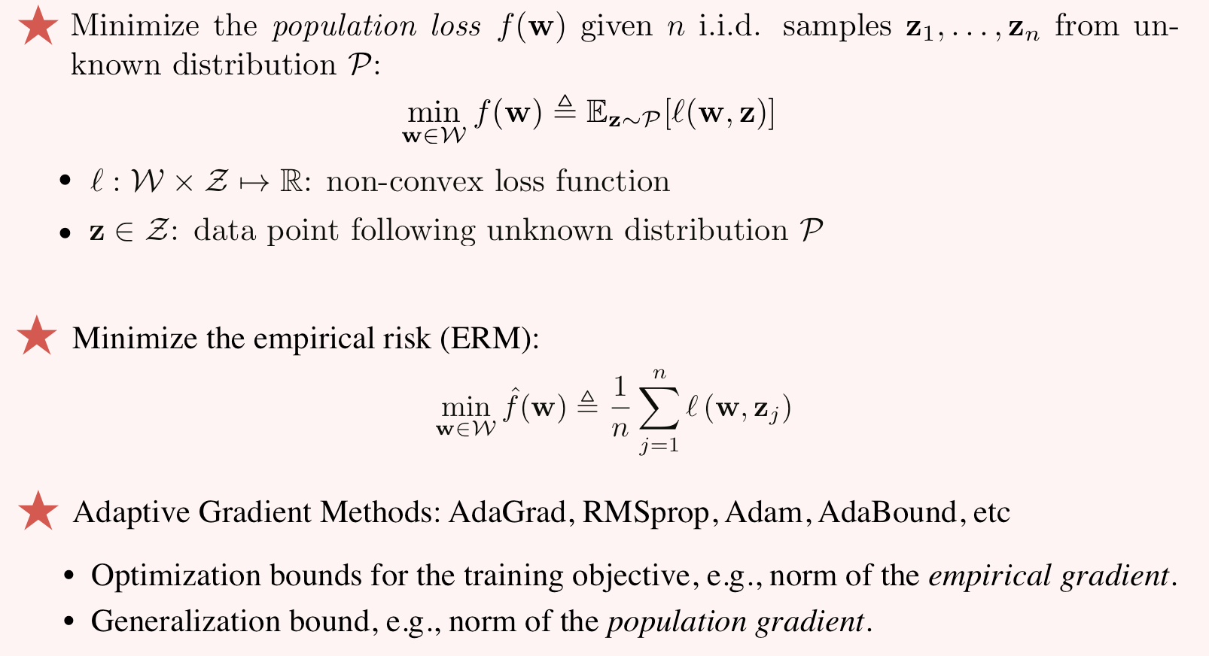
Stochastic non-convex optimization

Slide 4
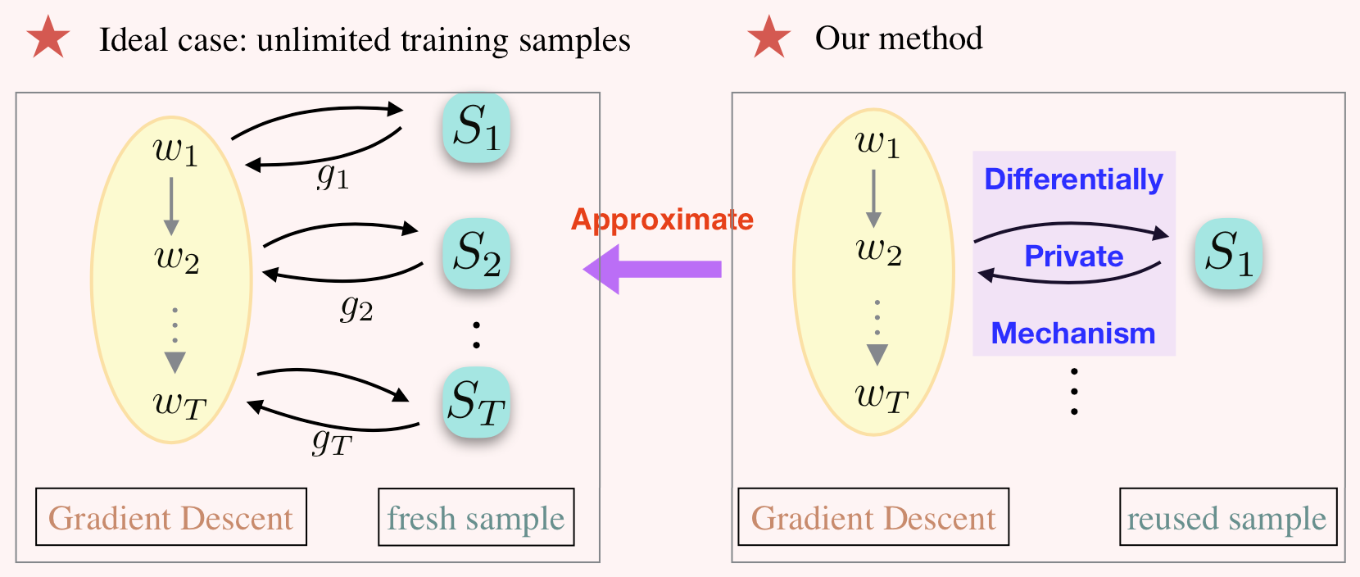
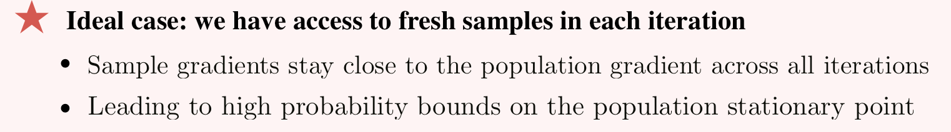
Main Idea

Slide 5
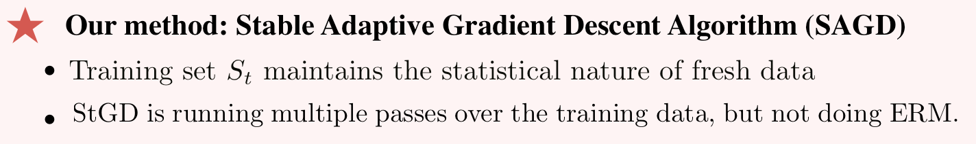
Main Idea

Slide 6
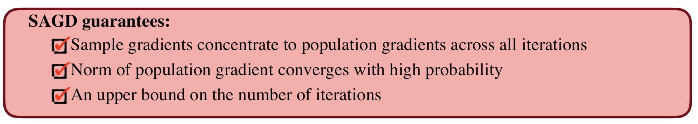
Main Idea

Slide 7
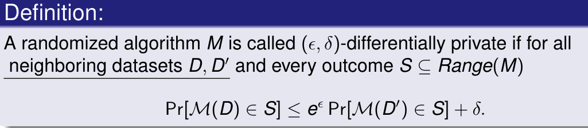
Differential Privacy
Main Point: There is no much difference between the output of the algorithm over two datasets that differ in one data element
Privacy budget
Probability of failure

Slide 8
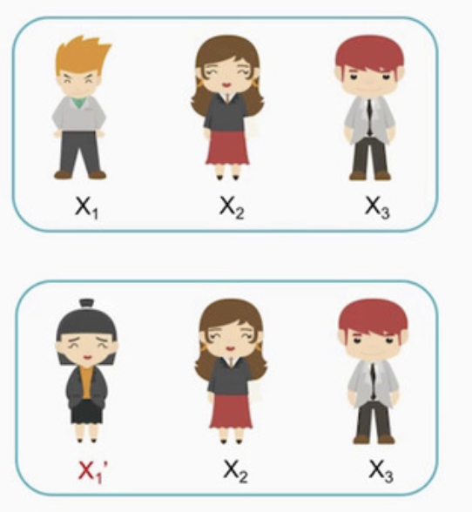
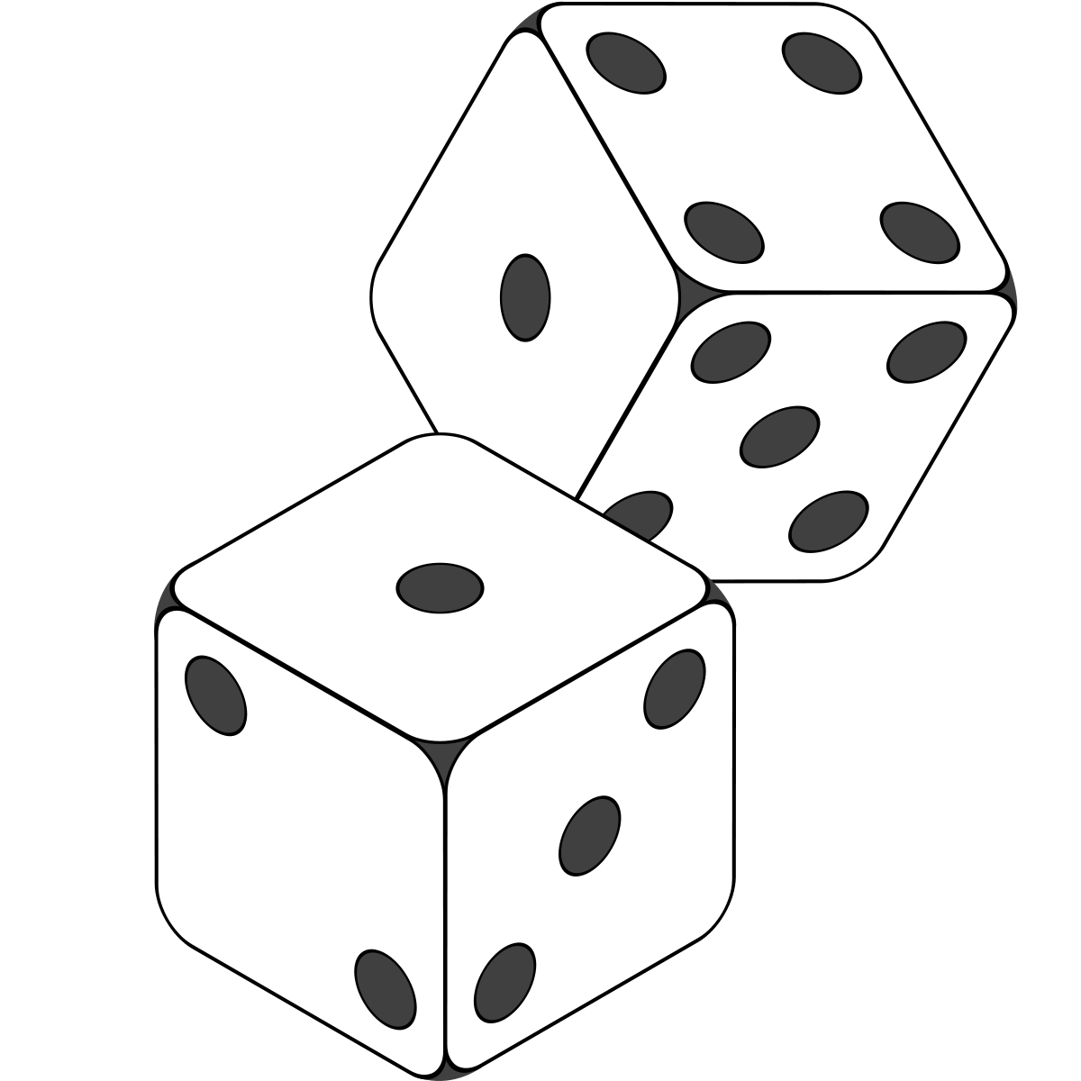
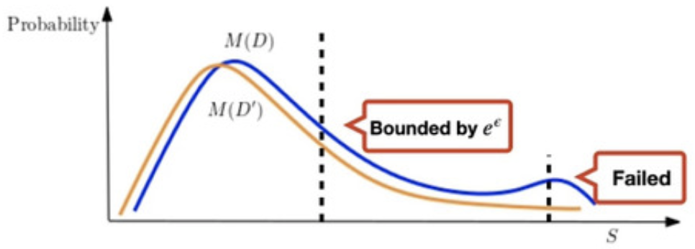
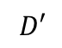
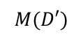
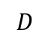
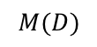
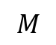
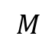
Differential Privacy
$$D$$
$$M$$
$$M(D)$$
$$D′$$
$$M(D′)$$
$$M$$

Slide 9
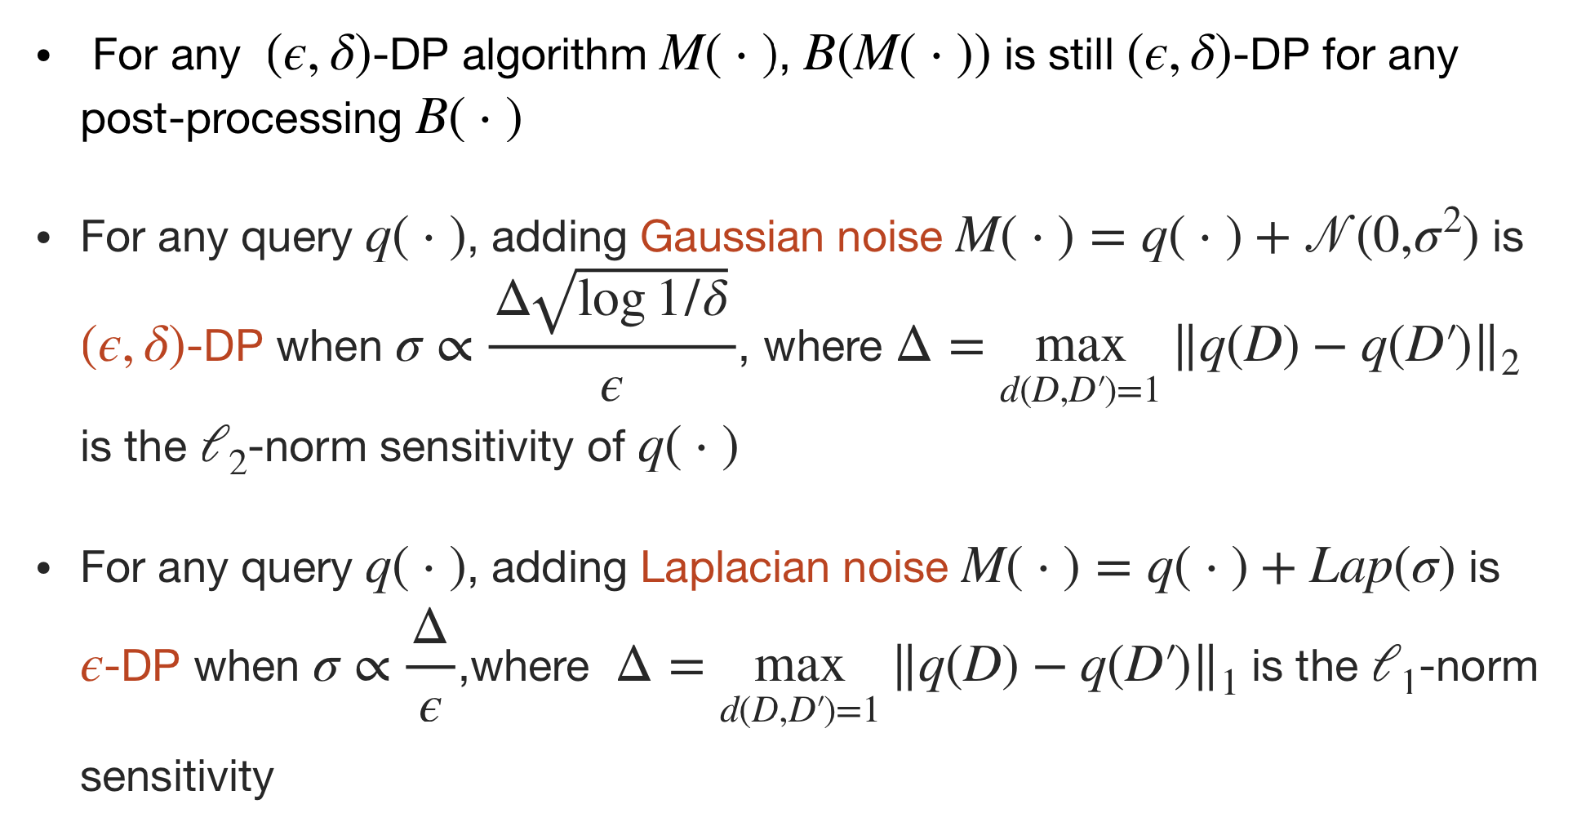
Basic properties of DP

Slide 10
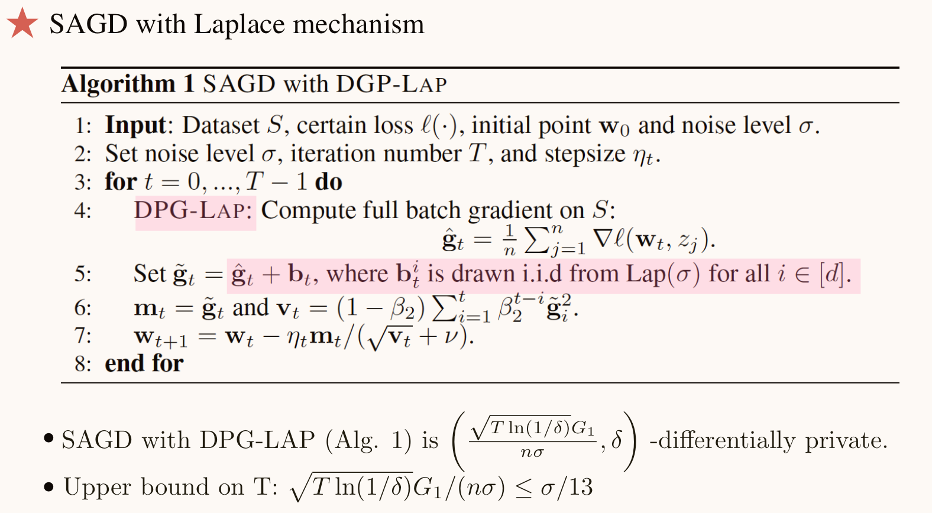
SAGD with Laplace mechanism

Slide 11
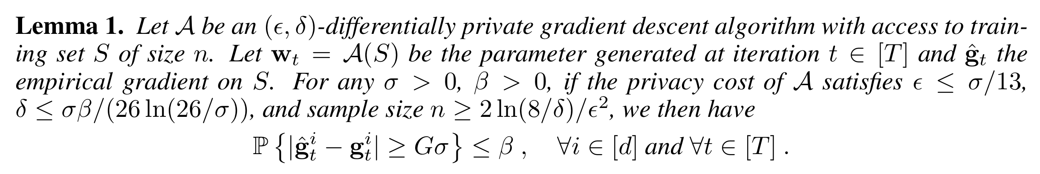
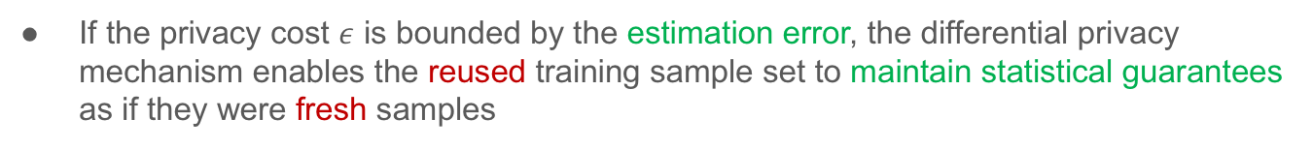
SAGD with Laplace mechanism
If the privacy cost $ε$ is bounded by the estimation error, the differential privacy mechanism enables the reused training sample set to maintain statistical guarantees as if they were fresh samples

Slide 12
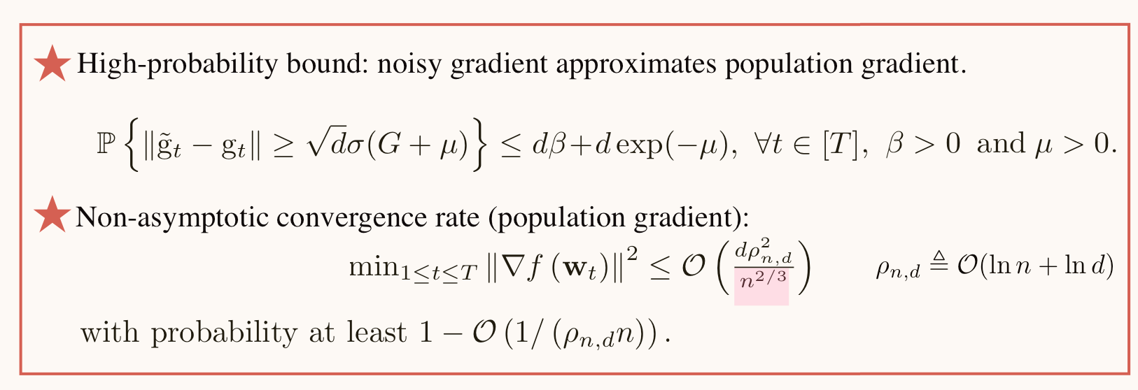
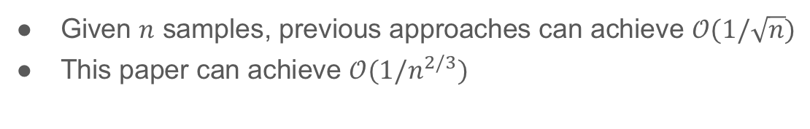
SAGD with Laplace mechanism
Given $n$ samples, previous approaches can achieve $𝒪(1/\sqrt{n})$
This paper can achieve $𝒪(1/n^{2/3})$

Slide 13
SAGD with Laplace mechanism

Slide 14
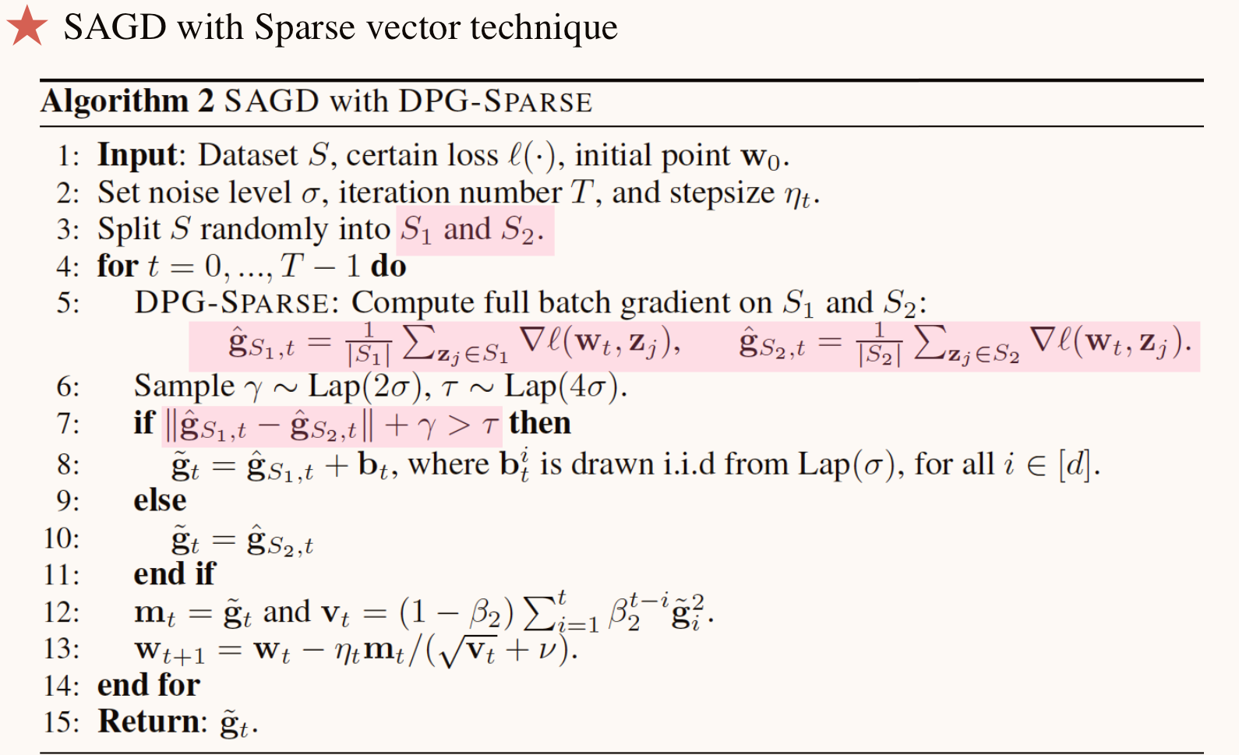
SAGD with Sparse vector technique

Slide 15
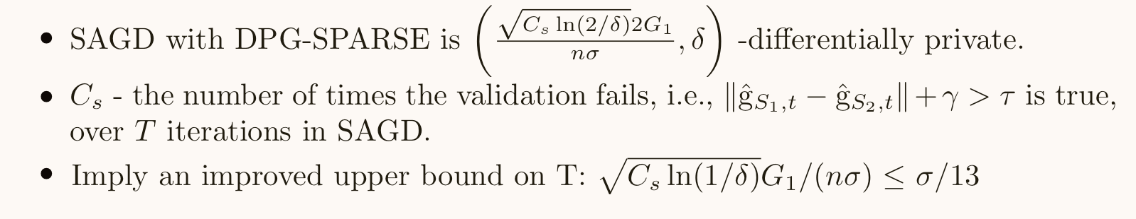
SAGD with Sparse vector technique

Slide 16
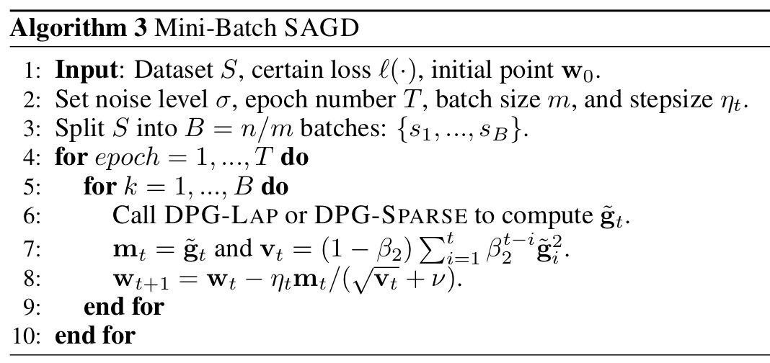
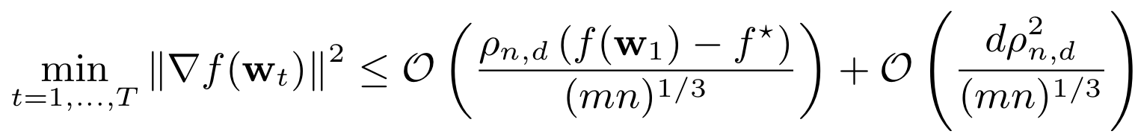
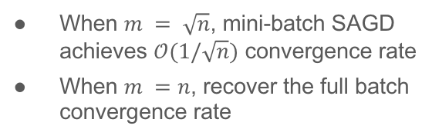
Mini-batch SAGD algorithm
When $m = \sqrt{n}$, mini-batch SAGD achieves $𝒪(1/\sqrt{n})$ convergence rate
When $m =n$, recover the full batch convergence rate
★ Non-asymptotic convergence rate (population gradient):

Slide 17
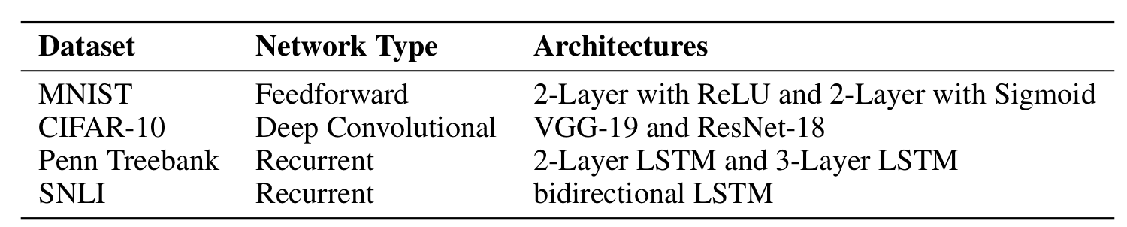
Experiments Settings
For each task, construct multiple training sets of different size by sampling from the original training set.
For MNIST, training sets of size n ∈ {50, 100, 200, 500, …} are constructed.
For CIFAR10, training sets of size n ∈ {200, 500, 1000, …} are constructed.

Slide 18
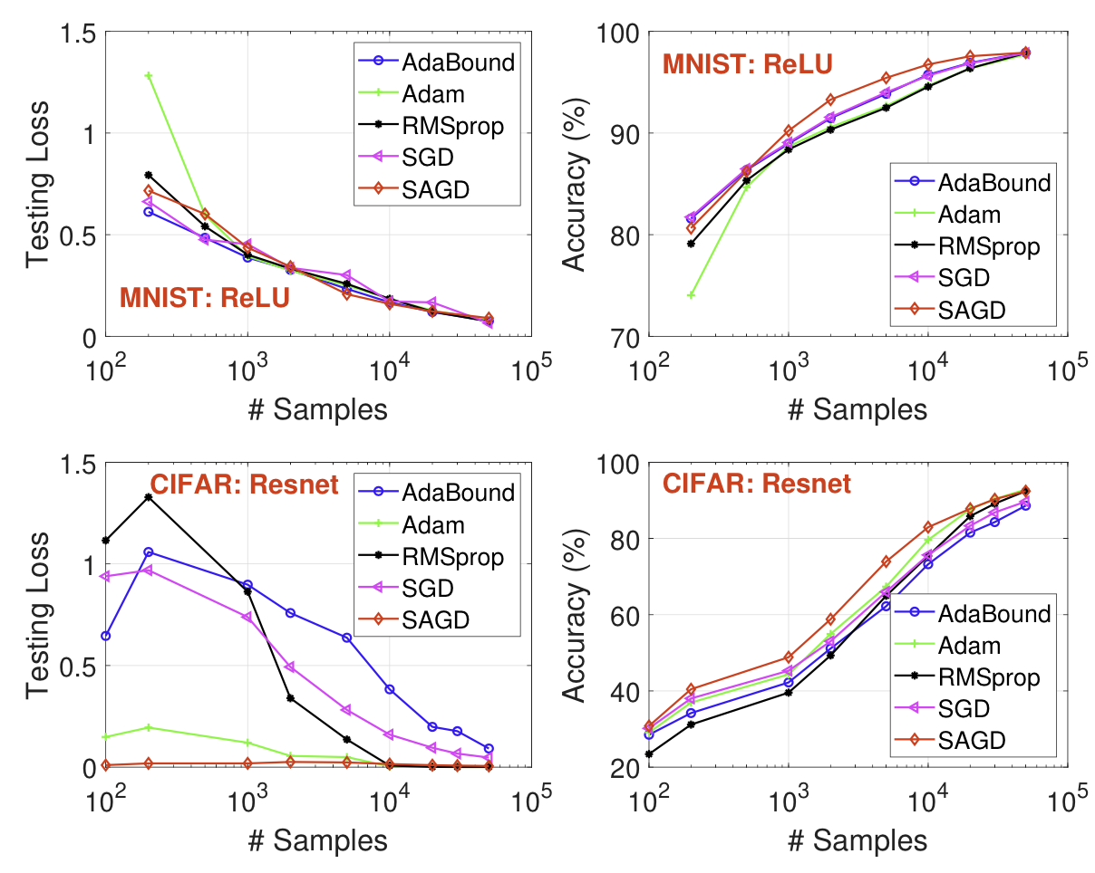
Experiments Results
Test loss and test accuracy of ReLU neural network on MNIST
Test loss and accuracy of ResNet-18 on CIFAR10
SAGD obtains the best test accuracy among all the methods

Slide 19
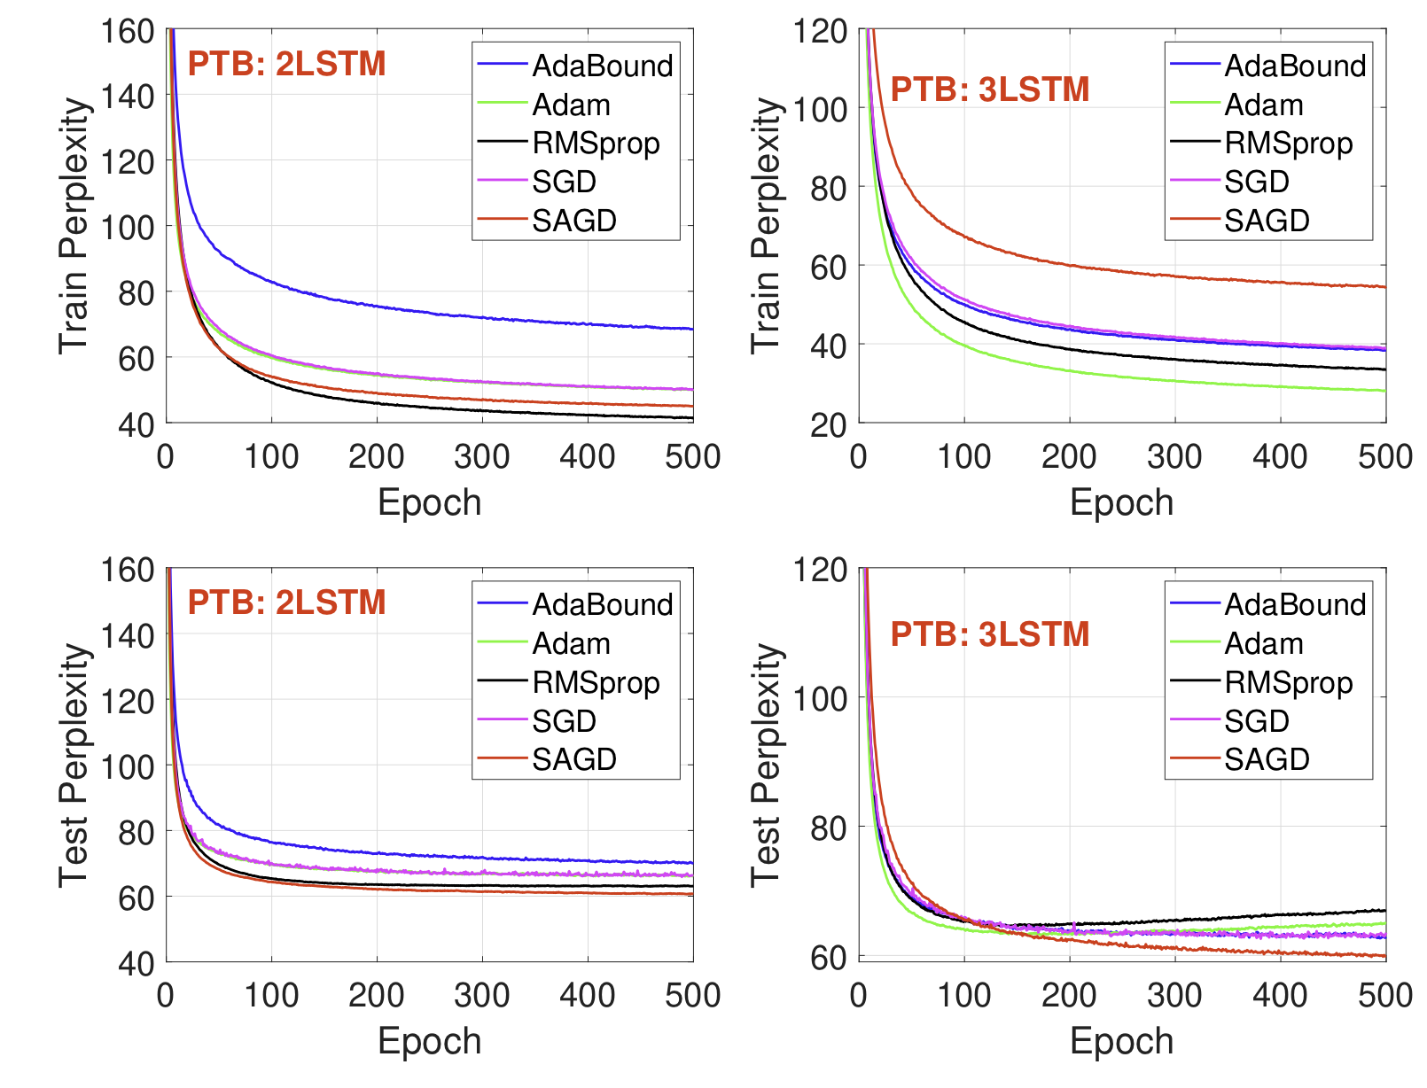
Experiments Results
Train and test perplexity of 2-layer LSTM (2LSTM), 3- layer LSTM (3LSTM)
Even though some baseline optimizers achieve better training performance than SAGD, the latter performs the best in terms of test perplexity among all methods.

Slide 20
Conclusions
Focus on the generalization ability of adaptive gradient methods
Propose SAGD algorithms, which boost the generalization performance in both theory and practice through a novel use of differential privacy
Experimental studies highlight that the proposed algorithms are competitive and often better than baseline algorithms for training deep neural networks

